Slide 1
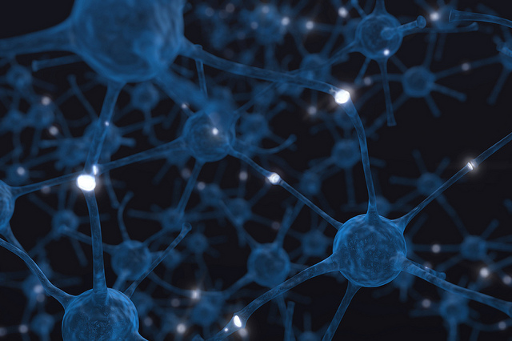

Neurons
[Professor Name]
[Class and Section Number]
Notes:
Classroom Recommendations: This module can be taught in one 90-minute class, or two-shortened class periods (45 to 60 minutes).
Overview: The purpose of this module is to introduce the student to the basic structure and function of neurons. The goal of this module is to become familiar with the anatomical structure of neurons and to understand how neurons communicate by electrochemical signals to process sensory information and produce complex behaviors through networks of neurons. This module will provide a firm foundation for future studies in psychology.
Technical Note: These slides may contain simple click animation so that you can focus students’ attention on a particular question, a selection of text, or an image and not have them be distracted by reading ahead. You can either preview the sequence of animation by going through the slides in slideshow view, visiting the animations tab, or reviewing the slide notes. In the notes you will see a cue - (Click) – that corresponds to each animation.
You may also find hyperlinks to outside videos at various places in the slides. These hyperlinks are embedded in text and indicated by color and in the notes section.

Slide 2
Learning Objectives
Differentiate the functional roles between the two main cell classes in the brain, neurons and glia.
Describe how the forces of diffusion and electrostatic pressure work collectively to facilitate electrochemical communication.
Define resting membrane potential, excitatory postsynaptic potentials, inhibitory postsynaptic potentials, and action potentials.
Explain the features of axonal and synaptic communication in neurons.
Notes:
This slide outlines the Learning Objectives for the module

Slide 3
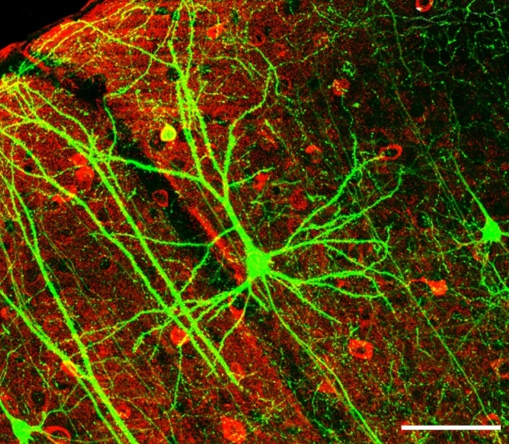
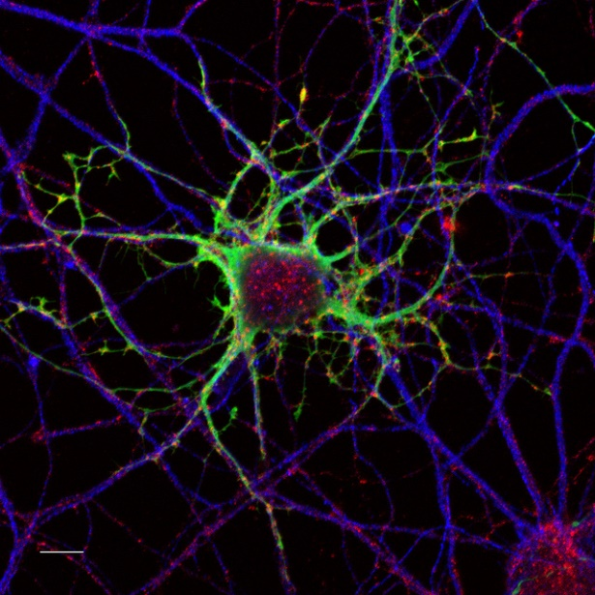
Warm Up
Write down what you already know about basic cells or specifically neurons or glia.
What are some questions you have about the structure and function of cells in the brain?
Notes:
The purpose of this slide is to help students scaffold their learning. It is intended to have them reflect on what they already know and let them think about what might interest them about the topic.
Have students take out some paper to write down what they already know about cells and what they want to know.
Give students five minutes to reflect and write down responses.
In a discussion, ask students to share what they know and what they might want to learn.
(Click): Write down what you already know about neurons and glia or basic cell processes.
(Click): Write down questions you may have about cells in the brain. Do you have questions about their structure? Do you have questions about their function?
Follow up by surveying the class about what students know (or think they know) and what they’d like to learn.

Slide 4
Overview
History of Neurons as Cells
Structure of the Neuron/Synapse
Types of Cells in the Brain
Communication within and between Neurons
Neurotransmission
Notes:
The purpose of this slide is to provide students with an overview of the material that will be covered during the lecture.

Slide 5
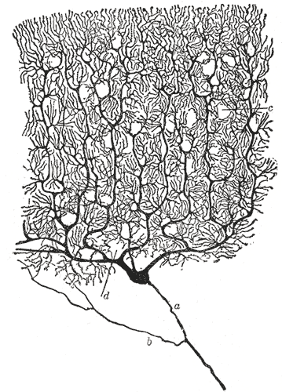
History of Neurons as Cells
Declares cells are discrete
Structural/functional units of nervous system
Notes:
This slide is intended to introduce students to the idea that neurons are discrete units of the nervous system.
Present/discuss important work of Ramon Cajal
He is the first person to identify neurons in the brain as discrete cells.
He combined the Golgi stain with the advances of the compound microscope.
(Click): Declares cells are discrete - These advances allowed the visualization of discrete cells in the nervous system.
(Click): Structural and functional units of nervous system - Cajal proposed that these discrete cells were the structural and functional units of the nervous system, providing a way for information to be communicated and processed in the brain.
This was in direct opposition to prevailing theories of the time that said the brain was an interconnected matrix rather than individual cells separated by space. It wasn’t until the development of the compound microscope and these special staining techniques that scientists were able to view discrete cells in the brain.

Slide 6
Overview
History of Neurons as Cells
Structure of the Neuron/Synapse
Types of Cells in the Brain
Communication within and between Neurons
Neurotransmission
Notes:
The purpose of this slide is to provide students with an overview of the material that will be covered during the lecture. This signals moving to the second topic of the structure of the Neuron and Synapse.

Slide 7
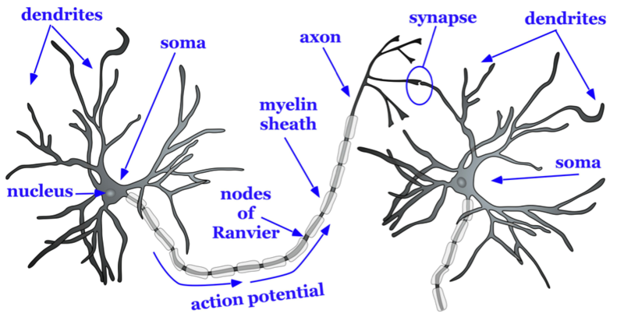
Structure of the Neuron
Notes:
The purpose of this slide is to give students a visual picture of the structure of the neuron with the specific features that will be covered in lecture.
Discuss the following terms while pointing them out on the diagram of the neuron.
Dendrites- Part of a neuron that extends away from the cell body and is the main input to the neuron.
Myelin Sheath- Lipid-based substance around the axon of a neuron that serves as insulation to allow the action potential to conduct rapidly toward the terminal buttons.
Soma- Cell body of a neuron that contains the nucleus and genetic information, and directs protein synthesis.
Nucleus- Found within the cell body, it contains the genetic material for the cell.
Axon- Part of the neuron that extends off the soma, splitting several times to connect with other neurons; main output of the neuron.

Slide 8
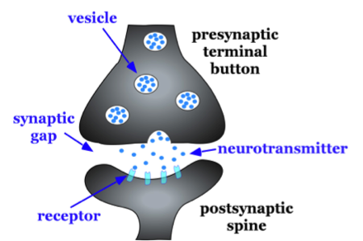
Structure of the Synapse
Notes:
The purpose of this slide is to familiarize students with the anatomy of the synapse. The instructor should point out the various structures while defining the function of each structure.
Vesicle- Packages containing neurotransmitter. They must bind to the cell membrane and dispense their neurotransmitter through a process using exocytosis (the process of having a synaptic vesicle containing various neurotransmitters fuse with the cell membrane and release the neurotransmitter into the synapse).
Terminal Button- The part of the end of the axon that form synapses with the postsynaptic dendrite, axon, or soma.
Presynaptic terminal button- The extension found at the end of the axon where information is conveyed to the next neuron.
Synaptic gap- Small space separating the presynaptic and postsynaptic cell. It is the space that neurotransmitter diffuses across to bind to receptors.
Neurotransmitter- Chemical substance released by the presynaptic terminal button that acts on the postsynaptic cell.
Receptor- The binding site for neurotransmitter. The neurotransmitter must fit in the receptor in a lock and key fashion and when it binds, it opens an ion channel that allows ions to flow into or out of the postsynaptic cell.
Spines- Protrusions on the dendrite of a neuron that form synapses with terminal buttons of the presynaptic axon.
Postsynaptic spine- Protrusions on the dendrite of a neuron that form synapses with terminal buttons of the presynaptic cell.

Slide 9
Overview
History of Neurons as Cells
Structure of the Neuron/Synapse
Types of Cells in the Brain
Functional Classification of Neurons
Structural Classification of Neurons
Glial Cells
Communication within and between Neurons
Neurotransmission
Notes:
The purpose of this slide is to provide students with an overview of the material that will be covered during the lecture

Slide 10
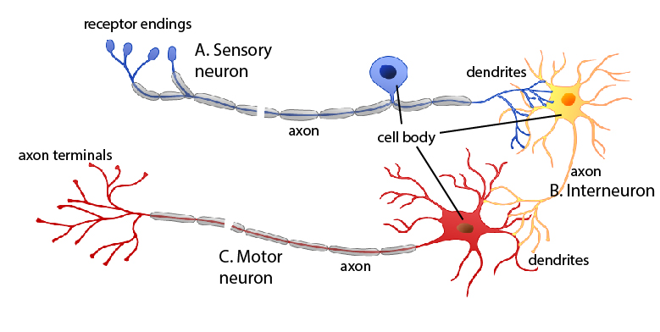
Types of Cells in the Brain
Functional Classifications of Neurons
Motor Neuron
Sensory Neuron
Interneuron
Notes:
This slide is intended to introduce students to the types of neurons there are based on the functional classification. It will introduce the motor neuron, sensory neuron, and interneuron as seen in the reflex arc.
The instructor can review the various neurons listed on the slide.
(Click): Motor Neuron-Allows us to initiate movement and behavior, ultimately allowing us to interact with the world around us.
(Click): Sensory Neuron-Helps us receive information about the world around us.
(Click): Interneuron-Processes the sensory input from our environment into meaningful representations, plan the appropriate behavioral response, and connect to the motor neurons to execute these behavioral plans.

Slide 11
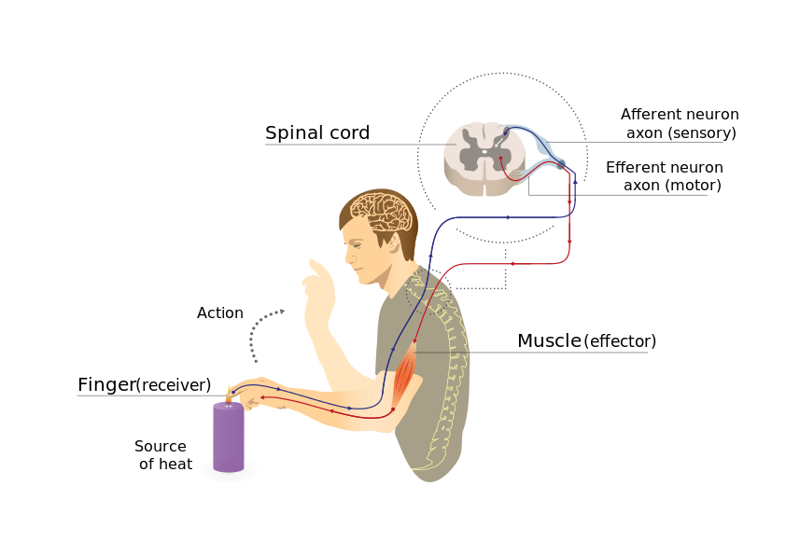
Types of Cells in the Brain
Functional Classifications of Neurons
Video: Reflex Arc
Notes:
This slide is intended to provide a video tutorial of the reflex arc and the role of each of these neurons (motor, sensory and interneurons) in the reflex. Discuss the important roll of reflexes in normal functions and responding to potentially harmful stimuli in the environment.
(Click): Video link: https://www.youtube.com/watch?v=M1E9Lm16cUs This video walks the viewer through a detailed review of sensory, motor and interneurons and their role in the reflex arc.
See below for an activity associated with reflexes:
Activity: Reflexes. Mythbusters: The explosive exhibition. Retrieved from http://www.mythbusterstheexhibition.com/assets/documents/uploads/08-MBedudoc-Reflexes-03.pdf.
Published by Mythbusters, this experiment allows students to measure the speed of a reflex. It outlines the reflex arc and promotes critical thinking about how reflexes work and what may impact their speed.

Slide 12
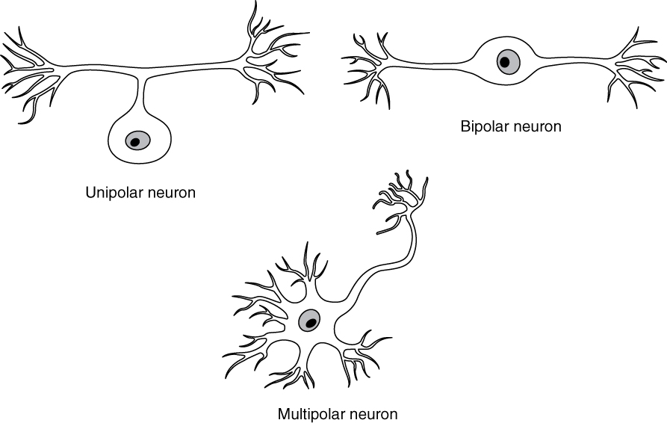
Types of Cells in the Brain
Functional Classifications of Neurons
Multipolar Neuron
Bipolar Neuron
Unipolar Neuron
Notes:
This slide is meant to introduce students to classifications of neurons based on their structure. It is easiest to show the students diagrams of the cell types and give them the characteristics of each cell type.
(Click): Multipolar neurons are the most common and they communicate sensory and motor information in the brain. For example, their firing causes muscles in the body to contract. Multipolar neurons have one axon and many dendrites which allows them to communicate with other neurons.
(Click): Bipolar neurons are involved in sensory perception such as perception of light in the retina of the eye. They have one axon and one dendrite which help acquire and pass sensory information to various centers in the brain.
(Click): Unipolar neurons are structured in such a way that is ideal for relaying information forward, so they have one neurite (axon) and no dendrites. They are involved in transmission of physiological information from the body’s periphery such as communicating body temperature through the spinal cord up to the brain.

Slide 13
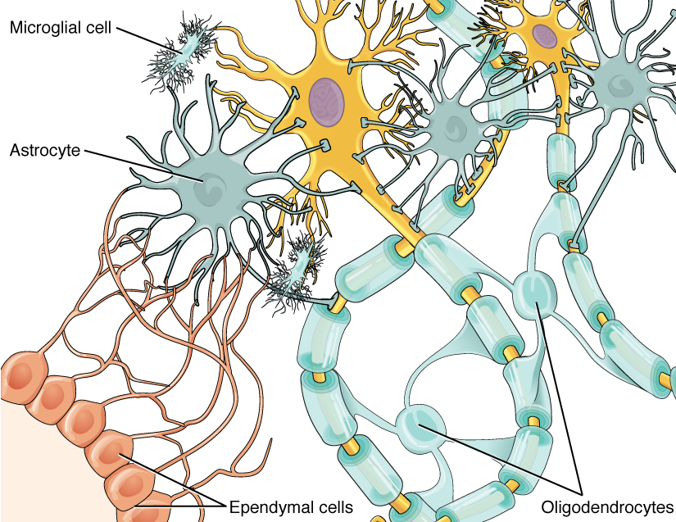
Types of Cells in the Brain
Glial Cells
Oligodendroglia (CNS)/Schwann (PNS)
Microglia
Astrocytes
Notes:
This slide is meant to introduce students to the various kinds of glial cells that support neurons in the brain.
Define glial cells and indicate their function in the nervous system. Explain that “glia” comes from the Greek word for “glue”. This is because early neuroanatomists believed that these cells provided critical structural support to the neurons of the brain. They acted like the glue that holds everything together.
(Click): Oligodendroglia/Schwann cells - These cells provide myelin in the CNS and PNS. The oligodendroglia provide myelin in the CNS where each oligodendroglia provides several “pads” of myelin around multiple nearby axons. Schwann cells are found in the PNS and each cell wraps around one segment of the elongated nerves found in the periphery.
(Click): Microglia function much like the macrophage in the immune system. They are responsible for identifying and chewing up substances that come into the brain that don’t belong there or cells that have died and need to be removed from the brain. So, they help identify if an infectious agent comes into the brain and they help clean up waste in the brain when cells die.
(Click): Astrocytes come from the Greek word for “star” because their shape resembles a star shape. Astrocytes function to support neurons by maintaining chemical balances in the brain, removing waste in the brain, and performing reparative functions in the brain. They also help in the formation of the brain-brain-barrier by creating tight junctions over the openings in the blood vessels.

Slide 14

Discussion
What’s the purpose of the blood-brain-barrier?
What types of harmful substances do we need to protect the brain from?
Does the blood-brain-barrier keep everything harmful out?
Notes:
This slide is intended to get students to think about what would happen if just anything could reach the brain. Set up this discussion question by explaining what the blood-brain-barrier is building off of having just discussed how the astrocytes form tight junctions around the capillaries of the brain.
Click: Why do we need the brain to have a blood-brain-barrier? Have students brainstorm about what would be the benefits of having an extra layer of protection around the brain.
Click: What types of harmful substances do we need to protect the brain from? Have students brainstorm what types of things might access the brain and be harmful. Suggest viruses, bacteria, drugs, and toxins if they do not come up in conversation.
Click: Is the blood-brain-barrier totally successful at keeping everything harmful out of the brain? Have students come up with examples of things that pass the barrier that may be harmful. Provide examples as needed to encourage discussion (such as alcohol, drugs, and infectious agents). Summarize the discussion and explain that the extra line of defense is not perfect, but it is extremely helpful as an added line of defense against harmful things gaining access to the brain.

Slide 15
Overview
History of Neurons as Cells
Structure of the Neuron/Synapse
Types of Cells in the Brain
Communication within and between Neurons
Resting Membrane Potential
Action Potential
Neurotransmission
Notes:
The purpose of this slide is to provide students with an overview of the material that will be covered during the lecture. This signals that you are moving on from discussing cell types and functions and beginning to discuss how cells communicate.

Slide 16
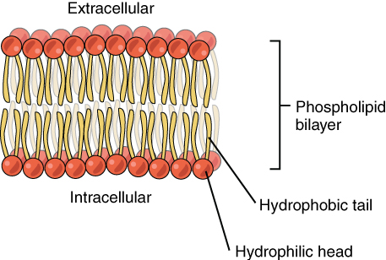
Communication within and between Neurons
Resting Membrane Potential
Cell membrane
Ion channels
-70mV
Notes:
The purpose of this slide is to introduce students to the cell membrane, the channels that are found within the membrane, and how the membrane helps to set up and maintain the resting membrane potential.
Discuss the makeup of the cell membrane and explain how the resting membrane potential is measured and maintained.
(Click): Cell membrane- The cell membrane is composed of a lipid bilayer of fat molecules and separates the cell from the surrounding extracellular fluid.
(Click): Ion Channels- There are proteins that pass the membrane, forming ion channels that allow particular ions to pass between the intracellular and extracellular fluid. These ions are in different concentrations inside the cell relative to the outside of the cell and these ions have different electrical charges.
(Click): -70mV – This is the resting membrane potential of the cell. It is created by a selective separation of ions across the cell membrane. The role of the ions in the resting membrane potential is explained in more detail on the next slide.

Slide 17
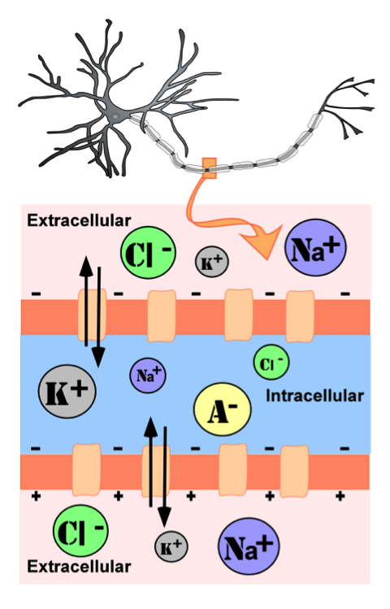
Communication within and between Neurons
Separation of Ions
Anions
Potassium
Chloride
Sodium
Pressures acting on ions
Diffusion
Electrostatic Pressure
Notes:
The purpose of this slide is to explain what ions play a role in neural communication and what types of pressures are acting on those ions during rest and during the action potential. Note that these ions are critical in driving the action potential down the axon.
Identify the ions that are used in the action potential.
(Click): Separation of Ions – Explain that that resting membrane potential is created by the separation of the ions across the membrane.
(Click): Anions are negatively charged and are unable to travel across the membrane through channels.
(Click): Potassium is a positively charged ion found in abundance inside the cell.
(Click): Chloride is a negatively charged ion found in abundance outside the cell.
(Click): Sodium is a positively charged ion found in abundance outside the cell.
(Click): Pressures acting on ions - Identify that two forces act to maintain a steady state when the cell is at rest.
(Click): Diffusion is the force on molecules to move from areas of high concentration to areas of low concentration.
Ask students to report where diffusion pressures are pushing potassium (outside cell), sodium (inside cell) and chloride (inside cell).
(Click): Electrostatic pressure is the force on two ions with similar charge to repel each other and the force of two ions with opposite charge to attract to another.
Ask students to report where electrostatic pressures are pushing potassium (inside cell), sodium (inside cell) and chloride (outside cell).

Slide 18

CAT: The Muddiest Point
What was the muddiest point about today’s class?
Write down the concept(s) you are still struggling to understand.
Notes:
Classroom Assessment Technique (CAT): The Muddiest Point
Ask students to write down the “muddiest point” – that is any concept they are still struggling to understand of any questions they still may have about the material. With remaining class time, ask students to share their muddiest point and provide additional review on these points.
If you do not conclude with this Classroom Assessment Technique (CAT), it would helpful to use another CAT. It could be in the form of a:
Muddy point
One-minute paper
Background knowledge
What’s the Principle?
Defining features Matrix:
For more information on CATs click here: http://cft.vanderbilt.edu/guides-sub-pages/cats/

Slide 19
Revisiting the CAT
Notes:
The purpose of this slide is to refresh students’ memories about what was covered in the first lecture and help them to understand things they are still confused about from the first lecture.
Address common themes that you identified from the CAT activity at the end of lecture one.

Slide 20
Overview
History of Neurons as Cells
Structure of the Neuron/Synapse
Types of Cells in the Brain
Communication within and between Neurons
Resting Membrane Potential
Action Potential
Neurotransmission
Notes:
The purpose of this slide is to provide students with an overview of the material that will be covered during the lecture. This signals that you are moving on from discussing cell types and functions and beginning to discuss how cells communicate.

Slide 21
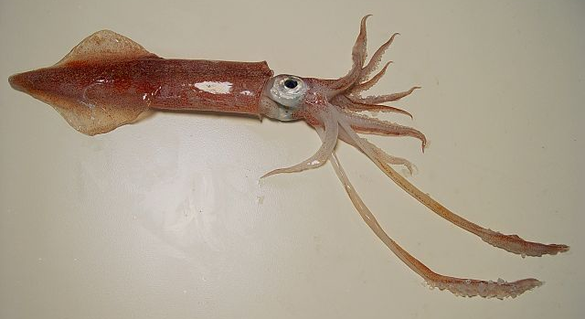
Communication within and between Neurons
Hodgkin and Huxley
Nobel Prize 1963
Electrochemical Transduction
Giant Squid Axon
Notes:
This slide explains the research that has helped neuroscientists understand how the action potential occurs in neurons.
The instructor should present the critical research of Hodgkin and Huxley in lecture format.
(Click): Nobel Prize 1963
In the 1930’s Hodgkin and Huxley began experiments that would earn them the Nobel Prize in Physiology or Medicine in 1963.
(Click): Electrochemical Transduction
The began experiments to measure the flow of electric current through the axon membrane.
(Click): Giant Squid Axon
They were able to complete these experiments because they discovered the giant squid had an axon that was unusually large and allowed them to insert a micropipette into the axon for the experiments.

Slide 22
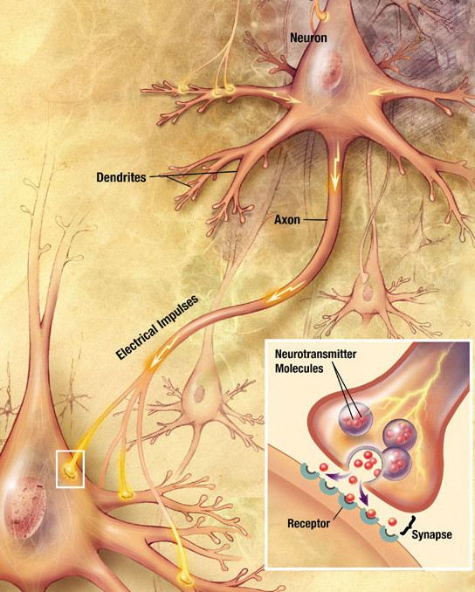
Communication within and between Neurons
Action Potential
Characteristics
All-or-nothing
Depolarized past threshold of excitation
Results in neurotransmitter release
Notes:
This slide introduces students to the characteristics of the action potential.
(Click): Characteristics of the Action Potential
(Click): All or nothing simply means that once an action potential begins, it will not diminish or stop in any way.
(Click): Depolarized past threshold of excitation - For an action potential to occur, the cell must experience a depolarization past the threshold of excitation (-50mV). These depolarizations occur through excitatory postsynaptic potentials which will be explained more on the next slide.
(Click): Results in neurotransmitter release - Once the action potential reaches the end of the terminal buttons, neurotransmitter is released into the synapse to pass the message on to the postsynaptic cell.

Slide 23
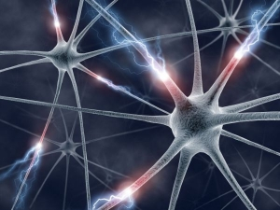
Communication within and between Neurons
How It’s Initiated
IPSP’s
EPSP’s
Summation across space
Summation across time
Notes:
This slide leads instruction on how cells can reach the threshold of excitation to begin the action potential.
(Click): How initiated – Explain how the flow of ions into the cell can either raise the membrane potential toward the threshold of excitation or it can reduce the membrane potential away from the threshold of excitation (hyperpolarization).
(Click): IPSP’s – are Inhibitory Post Synaptic Potentials. These potentials result when either positively charged ions leave the cell or negatively charged ions enter the cell.
(Click): EPSP’s – are Excitatory Post Synaptic Potentials. These potentials result when either positively charged ion’s enter the cell.
(Click): Summation across time
(Click) Summation across space
Explain that a single IPSP’s and EPSP’s rarely ever happen. Most often a cell is receiving multiple messages at once. So, often EPSP’s and IPSP’s have to be summed across time or across the space of the neuron.
Use the link to the video for an animation of temporal and spatial summation.
Video: https://www.youtube.com/watch?v=oLSmNcem2X0

Slide 24
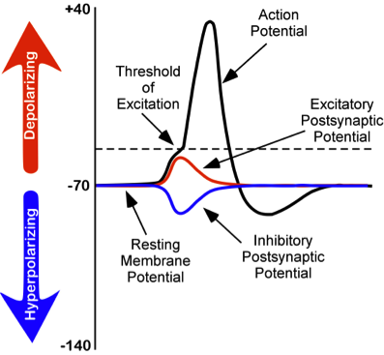

Communication within and between Neurons
Action Potential
Change in neuron potential during action potential
Na+ channels open
Both diffusion and electrostatic pressure pushes Na+ into the cell
As Na+ is rushing in, K+ channels open
Notes:
This slide is one of two that walks students through the processes that must occur for an action potential.
The instructor should walk the student through the process using the picture of the changing membrane potential.
(Click): Change in neuron potential during action potential – Describe how the action potential is dependent upon the exchange of the ions previously discussed (Na+ and K+) that lie on either side of the membrane.
(Click): Na+ channels open – Explain that when the cell reaches the threshold of excitation that sodium channels pop open.
(Click): Both diffusion and electrostatic pressure pushes Na+ into the cell - Explain that when sodium channels open, that sodium is under both diffusion and electrostatic pressure to rush across the membrane and into the cell. Therefore, sodium moves very quickly across the membrane through the ion channels.
(Click): As Na+ is rushing in, K+ channels open – Explain that as the charge on the inside of the cell is increasing due to the influx of Na+, that K+ channels will open to begin to let K+ back out of the cell.
See Instructors Manual for an activity associated with action potentials.

Slide 25
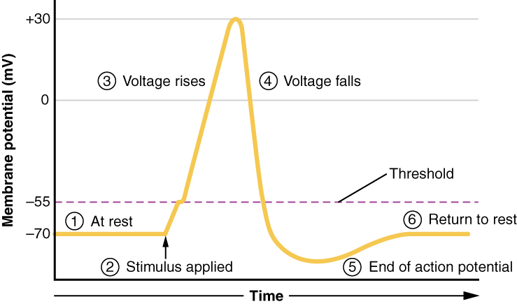
Communication within and between Neurons
Action Potential
At the peak of the action potential Na+ channels close
Diffusion and electrostatic pressure force K+ out
Cell undergoes a brief hyperpolarization
Notes:
This slide continues the step-by-step description of the action potential
(Click): At the peak of the action potential Na+ channels close – Indicate that when the cell reaches its highest charge, the sodium channels will close.
(Click): Diffusion and electrostatic pressure force K+ out – Explain that when the cell has become more positively charged on the inside of the cell that K+ will be under both diffusion and electrostatic pressure to now leave the cell.
(Click): Cell undergoes a brief hyperpolarization – Explain that as K+ leaves the cell, the charge on the inside of the cell begins to move more negatively. The cell will actually move past its normal resting membrane potential for a brief period.

Slide 26
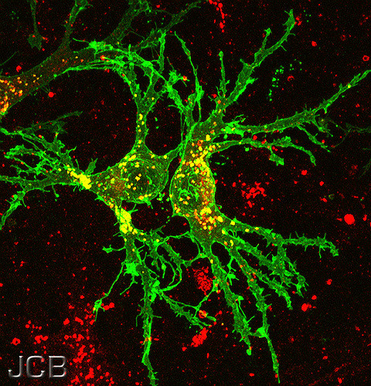
Communication within and between Neurons
Nerve Impulse
Notes:
This slide contains a link to a video animation of the neural impulse.
https://www.youtube.com/watch?v=fHRC8SlLcH0

Slide 27
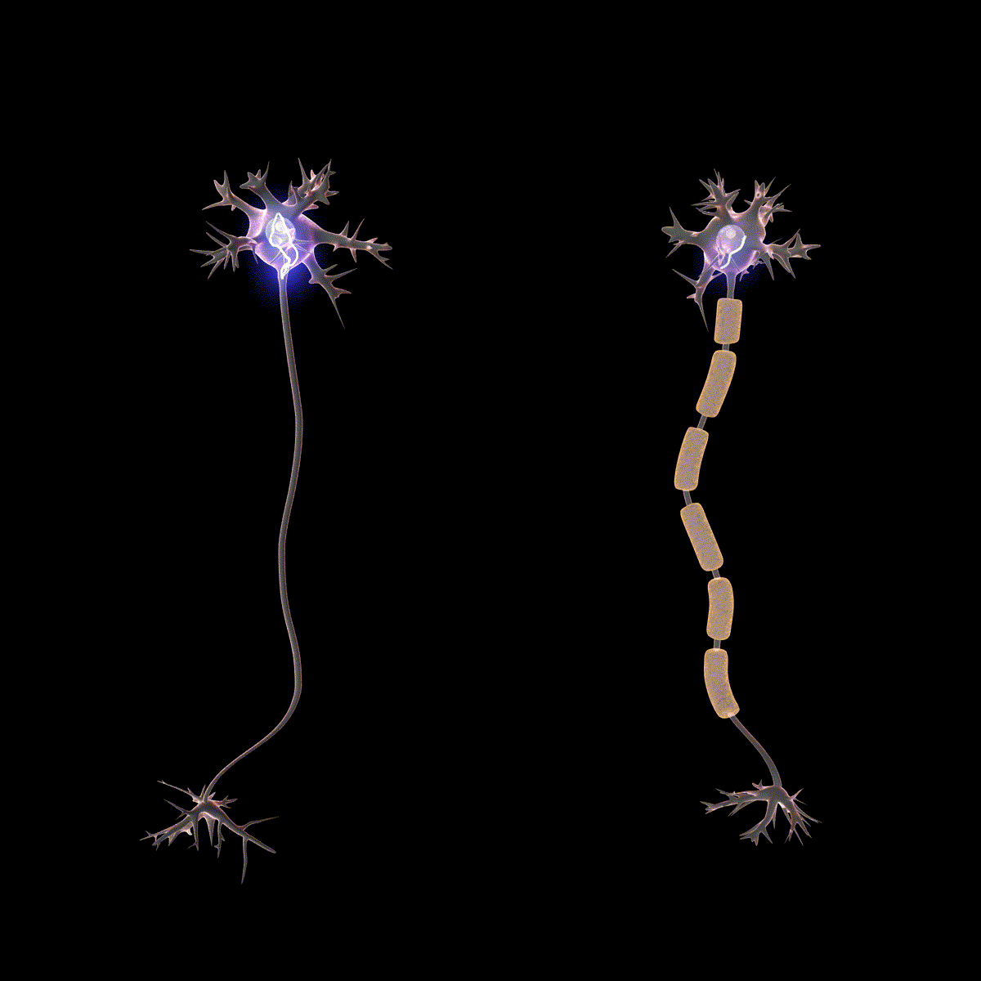
Communication within and between Neurons
Action Potential in Myelinated Axons
Myelin speeds the process
Action potentials occur at each Node of Ranvier
Saltatory Conduction
Notes:
This slide introduces the idea that myelin speeds up action potentials.
(Click): Myelin speeds the process – Describe how myelin covers much of the axon, which saves time because the action potential doesn’t need to occur at every little segment of the neuron.
(Click): Action potentials occur at each Node of Ranvier – Point out that action potentials only need to occur at each segment of the axon that is bare. These spaces are called Nodes of Ranvier.
(Click): Saltatory Conduction – When the action potential skips from Node of Ranvier to the next Node of Ranvier, it is called saltatory conduction.
See Instructor Manual for activity associated with myelinated axons.

Slide 28
Colossal Neurons Activity
Notes:
The purpose of this slide is to introduce the Colossal Neurons Activity.
Time: 20 minutes.
Source: Holloway, S. R. (2013). Three colossal neurons: A new approach to an old classroom demonstration. Journal of Undergraduate Neuroscience Education, 12(1), A1–A3. Retrieved from http://www.ncbi.nlm.nih.gov/pmc/articles/PMC3852864/
Materials:
A very large space
Masking tape (or painter’s tape if using a tile floor)
Styrofoam chips
Three to twelve lunch-size paper bags
Several large plastic cups
Sodium/potassium placards
Paper identification signs
Directions:
Student assignments (students per neuron):
Sense Organ (1)
Receiving Dendrite (who holds a cup in his or her hands denoting the receptor sites) (1 - inter and motor neurons only)
Sodium (who carries placards and stands outside the neuron) (1 or more)
Potassium (who carries placards and stands inside the neuron) (1 or more)
(Optional) Sodium/Potassium Pump (who taps the sodium and potassium ions to make them return) (1)
Action Potential (who runs down the axon and taps the terminal button) (1) OR
Action Potential (who stands with others and lifts arms) (3 or more)
Terminal Button (who holds a bag of Styrofoam chips and throws the Styrofoam chips at the receiving dendrite) (1)
(Optional) Re-uptake Ducts (who picks up chips from the floor and fills a new bag/vesicle) (1)
Crier (1 - motor neuron only)
Procedure
On the floor, outline the shape of three neurons (sensory, inter, and motor) using the masking tape. Adjust the size and length of each neuron according to the number of students who will be participating. Make sure that the synaptic clefts are far enough apart to challenge the students throwing the chips (eight to ten feet). Freshmen can get very competitive and will sometimes try to lean over or even step out of the neuron into the synaptic cleft. When roles have been assigned and students are in place, the “annoying little brother” played by the instructor, teaching assistant, or helper touches the sense organ (a bruise) who begins the neural transmission by turning to face the inside of the neuron. This unlocks the ion channels, allowing potassium to begin flowing out of the neuron, and sodium to begin flowing into the neuron (1:1 ratio). The sodium/potassium pump, who is straddling the edge of the neuron, then starts tapping the ions (one of each kind, in succession), so that they quickly return to their original positions in order to be ready for another signal from the sense organ.
Meanwhile, as soon as the sodium and potassium students trade places and the all-or-nothing threshold (as determined by the instructor) is reached, the action potential students will begin to raise their hands in succession, as if performing a “wave” similar to those seen in sports arenas, simulating the depolarization racing down the axon. The last action potential person taps the terminal button, who is holding a vesicle (paper bag) filled with neurotransmitters (Styrofoam chips); the vesicle opens, and the terminal button “releases” (throws) the neurotransmitters into the synaptic cleft. Alternatively, if there is only one student available for the role of action potential, that student should simply run down the axon and tap the terminal button. When a chip lands in the “receptor site” (cup) on the receiving dendrite of the next neuron (the inter-neuron), the receiving dendrite turns around, unlocking the gates, and the process repeats with the inter-neuron, ultimately causing the motor neuron to fire. If the synaptic cleft has been laid out with enough distance between the terminal button and the receiving dendrite, it can take several bags of chips to have one actually land in a receiving cup. When the last neuron’s terminal button (motor neuron) is tapped by the action potential, the terminal button taps the crier, who shouts “Ouch,” inspiring the “annoying little brother” to touch the bruise again.
Research has shown that students participating in the demonstration score higher on exam questions associated with neural transmission (http://www.ncbi.nlm.nih.gov/pmc/articles/PMC3852864/).

Slide 29
Overview
History of Neurons as Cells
Structure of the Neuron/Synapse
Types of Cells in the Brain
Communication within and between Neurons
Neurotransmission
Notes:
The purpose of this slide is to provide students with an overview of the material that will be covered during the lecture. This slide indicates you are moving on to the last topic in the lecture.

Slide 30
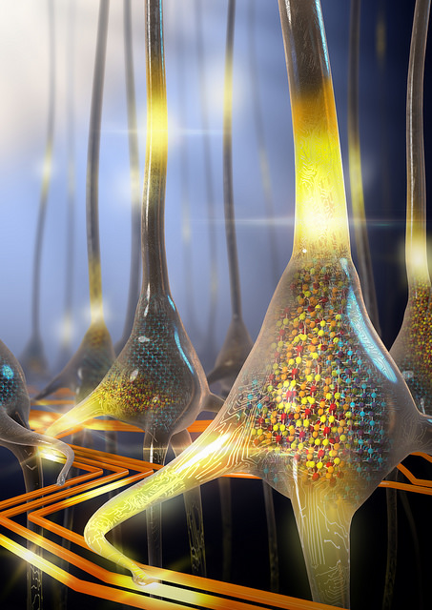
Communication within and between Neurons
Neurotransmission
Neurotransmission is chemical
Notes:
The purpose of this slide is to introduce the topic of neurotransmitter release and the impact of that release on the postsynaptic cell.
View Video on how Otto Loewi discovered that neurotransmission is chemical. (https://www.youtube.com/watch?v=RyfJwisRxvs)

Slide 31
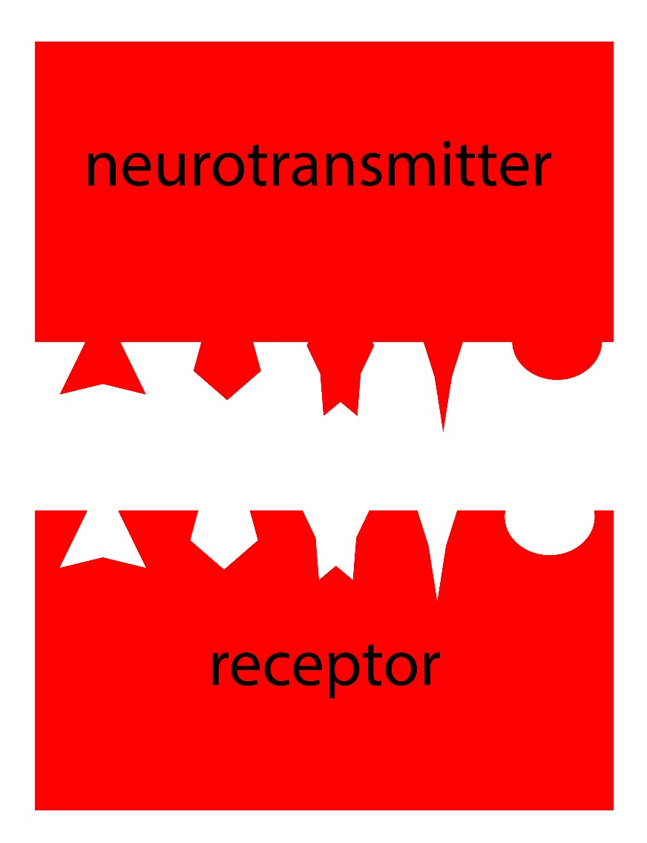
Communication within and between Neurons
Neurotransmission
Neurotransmitter release
Binds in lock and key fashion
Ionotropic/Metabotropic receptors
Results in IPSP’s and EPSP’s
Notes:
The purpose of this slide is to introduce the topic of neurotransmitter release and the impact of that release on the postsynaptic cell.
(Click): Neurotransmitter release – Explain that when the action potential arrives at the axon terminal, it results in the vesicles merging with the cell membrane and through exocytosis, they release neurotransmitter into the synapse.
(Click): Binds in lock and key fashion – Explain how neurotransmitter diffuses across the synapse and binds to receptor in a lock and key fashion.
(Click): Ionotropic/Metabotropic receptors – Explain that neurotransmitter binding allows ion channels to open up and ions can flow either into or out of the cell in response.
(Click): Results in IPSP’s and EPSP’s – Explain that the flow of ions results in IPSP’s (hyperpolarizations) or EPSP’s (depolarizations) in the receiving cell. Tie this back to the information on temporal and spatial summation and how it can result in an action potential in the receiving neuron.

Slide 32
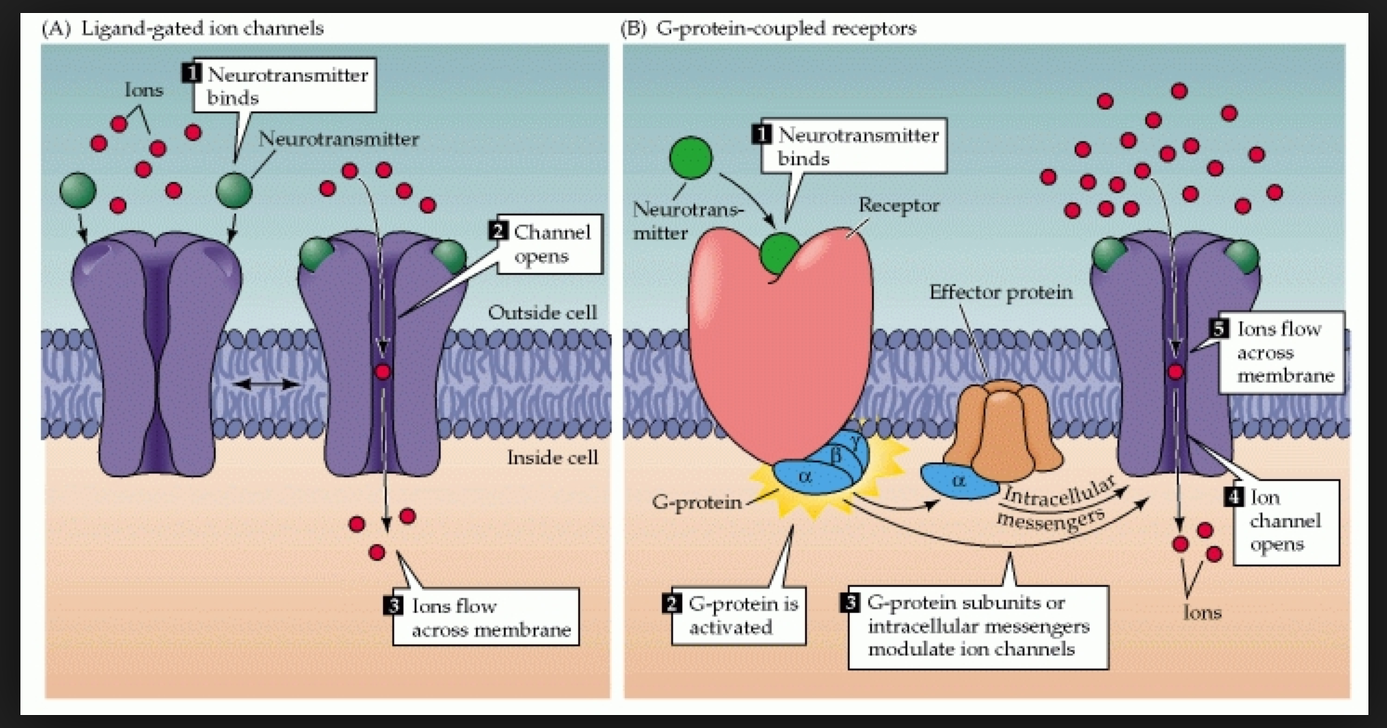
Neurotransmission
Glutamate-EPSP’s
Na+ enters cell
Ca++ enters cell
GABA-IPSP’s
K+ leaves cell
Cl- enters cell
Notes:
This slide introduces how the EPSP’s and IPSP’s can occur by the flow of ions after neurotransmitters bind to their receptors.
Examples – Explain that IPSP’s and EPSP’s can occur through the flow of ion’s after neurotransmitters bind to their receptors.
(Click): Glutamate – Explain that glutamate is an excitatory neurotransmitter so it results in EPSP’s
(Click): Na+ enters cell – Explain that an EPSP can occur when Na+ enters the cell
(Click): Ca++ enters cell – Explain that an EPSP can occur when Ca++ enters the cell
(Click): GABA – Explain that GABA is an inhibitory neurotransmitter so it results in IPSP’s
(Click): K+ leaves cell – Explain that inhibition can occur when K+ leaves the cell
(Click): Cl- enters cell – Explain that inhibition can occur when Cl- enters the cell
For more information please see: http://nobaproject.com/modules/neurons#the-change-in-membrane-potential-during-an-action-potential

Slide 33
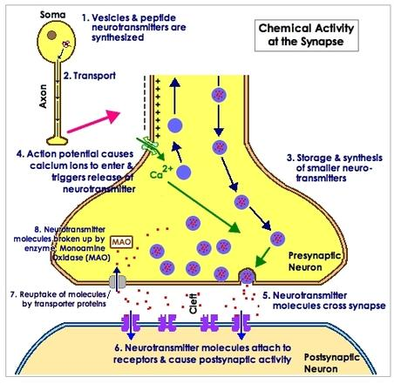
Neurotransmission
Termination of neurotransmission
Enzymes
Reuptake
Summary/Review Neurotransmission
Notes:
This slide presents the final stage of neurotransmission where the excess neurotransmitter has to be removed from the synapse.
Describe the processes that are used to remove excess neurotransmitter from the synapse and then show video to summarize the neurotransmission process.
(Click): Termination of neurotransmission – Explain that once neurotransmitter is released in the synapse, it will continue to bind to receptors and pop off the receptor and bind again. This can be dangerous and lead to overexcitation. So, the brain has to have a way to remove the neurotransmitter from the synapse.
(Click): Enzymes – One method that is used to remove neurotransmitter from the synapse is through enzymes. Enzymes can find neurotransmitter in the synapse and break it down before it can bind to the receptors again.
(Click): Reuptake – Another method used to removed transmitter is to have the neurotransmitter taken back up by the cell that released it. Once the neurotransmitter is back in the presynaptic cell, it can be broken down by enzymes or repackaged into vesicles to be used again.
(Click): Video – Summary of neurotransmission https://www.youtube.com/watch?v=p5zFgT4aofA

Slide 34
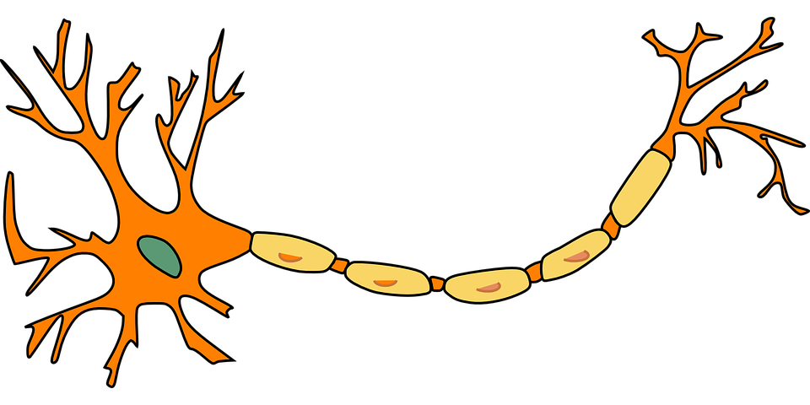
CAT: One Minute Paper
What was the most important thing you learned during this section on neurons?
What important question remains unanswered?
Notes:
Classroom Assessment Technique (CAT): One-Minute Paper
If you are presenting the information on one class day, you might end the material about here. End your class time with a one-minute paper.
The Minute Paper tests how students are gaining knowledge, or not. The instructor ends class by asking students to write a brief response to the following questions: “What was the most important thing you learned during this class?” and “What important question remains unanswered?”
Have students briefly answer these questions in writing and turn them in. After class, assess students’ responses. At the beginning of the next class, go over any misunderstandings or relevant questions.
If you do not conclude with this Classroom Assessment Technique (CAT), it would helpful to use another CAT. It could be in the form of a:
Muddy point
One-minute paper
Background knowledge
What’s the Principle?
Defining features Matrix:
For more information on CATs click here: http://cft.vanderbilt.edu/guides-sub-pages/cats/

Slide 35
Photo Attribution
Slide 1 | Photo Credit: Neurons Birth Into Being https://www.flickr.com/photos/111359165@N05/11841180046 https://creativecommons.org/licenses/by-nc-sa/2.0/
Slide 3 | Photo Credit: Myelin transport in neurons The Journal of Cell Biology https://www.flickr.com/photos/43875334@N07/4118734396/ https://creativecommons.org/licenses/by-nc-sa/2.0/ Photo Credit: Neurons, confocal fluorescence microscopy ZEISS Microscopy https://www.flickr.com/photos/75834543@N06/8695004301/ https://creativecommons.org/licenses/by-nc-nd/2.0/
Slide 5 | Photo Credit: Drawing of a Purkinje cell in the cerebellar cortex PNG crusade bot https://en.wikipedia.org/wiki/Neuron#/media/File:Purkinje_cell_by_Cajal.png Public Domain
Slide 7 | Photo Credit: Basic Structure of a Neuron. Noba Staff. http://nobaproject.com/modules/neurons#the-structure-of-the-neuron https://creativecommons.org/licenses/by-nc-sa/4.0/deed.en_US
Slide 8 | Photo Credit: Characteristics of a Synapse. Noba Staff. http://nobaproject.com/modules/neurons#types-of-cells-in-the-brain https://creativecommons.org/licenses/by-nc-sa/4.0/deed.en_US
Slides 10 & 28 | Photo Credit: The three general classes of neurons OpenStax https://cnx.org/contents/pMqJxKsZ@6/Nervous-System http://creativecommons.org/licenses/by/4.0/
Slide 11 | Photo Credit: A normal spinal cord reflex arc MartaAguayo https://en.wikipedia.org/wiki/Axon_reflex#/media/File:Imgnotra%C3%A7at_arc_reflex_eng.svg https://creativecommons.org/licenses/by-sa/3.0/
Slide 12 | Photo Credit: Neuron Classification by Shape UC Davis Bio Wiki http://biowiki.ucdavis.edu/Textbook_Maps/OpenStax_Anatomy_and_Physiology/Unit_3%3A_Regulation,_Integration,_and_Control/12%3A_The_Nervous_System_and_Nervous_Tissue/12.2%3A_Nervous_Tissue http://creativecommons.org/licenses/by-nc-sa/3.0/us/
Slides 13 & 19 | Photo Credit: Glial Cells of the CNS UC Davis Bio Wiki http://biowiki.ucdavis.edu/Textbook_Maps/OpenStax_Anatomy_and_Physiology/Unit_3%3A_Regulation,_Integration,_and_Control/12%3A_The_Nervous_System_and_Nervous_Tissue/12.2%3A_Nervous_Tissue http://creativecommons.org/licenses/by-nc-sa/3.0/us/
Notes:
Photo Attribution Slide

Slide 36
Photo Attribution
Slide 14 | Photo Credit: Questions1 Grisel D´An https://www.flickr.com/photos/128454566@N06/15893429463 https://creativecommons.org/licenses/by-nc/2.0/
Slide 16 | Photo Credit: Phospholipid Bilayer OpenStax https://cnx.org/contents/d8StM2nX@1/The-Plasma-Membrane http://creativecommons.org/licenses/by/4.0/
Slide 17 | Representation of ion concentrations inside (intracellular) and outside (extracellular) a neuron in the unmylenated segment of the axon. Noba Staff http://nobaproject.com/modules/neurons#resting-membrane-potential https://creativecommons.org/licenses/by-nc-sa/4.0/deed.en_US
Slide 21 | Photo Credit: Longfin inshore squid ( Loligo pealeii ) SEFSC Pascagoula Laboratory; Collection of Brandi Noble, NOAA/NMFS/SEFSC https://commons.wikimedia.org/wiki/File:Loligo_pealeii.jpg#/media/File:Loligo_pealeii.jpg Public Domain
Slide 22 | Photo Credit: Chemical Synapse US National Institutes of Health, National Institute on Aging https://en.wikipedia.org/wiki/Chemical_synapse#/media/File:Chemical_synapse_schema_cropped.jpg Public Domain
Slide 23 | Photo Credit: brain-neurons Fotis Bobolas https://www.flickr.com/photos/fbobolas/3822222947 https://creativecommons.org/licenses/by-sa/2.0/
Slide 24 | Photo Credit: Changes in Membrane Potentials of Neurons. Noba Staff. http://nobaproject.com/modules/neurons#action-potential https://creativecommons.org/licenses/by-nc-sa/4.0/deed.en_US
Slide 25 | Photo Credit: Version 8.25 from the Textbook OpenStax Anatomy and Physiology Published May 18, 2016 OpenStax https://commons.wikimedia.org/wiki/File:1222_Action_Potential_Labels.jpg#/media/File:1222_Action_Potential_Labels.jpg https://creativecommons.org/licenses/by/4.0/
Slide 26 | Photo Credit: Myelin transport in neurons The Journal of Cell Biology https://www.flickr.com/photos/43875334@N07/4118734396/ https://creativecommons.org/licenses/by-nc-sa/2.0/
Slide 27 | Photo Credit: Myelin and Saltatory Conduction Dr. Jana https://en.wikipedia.org/wiki/Action_potential#/media/File:Saltatory_Conduction.gif http://creativecommons.org/licenses/by/4.0/
Notes:
Photo Attribution Slide

Slide 37
Photo Attribution
Slide 30 | Photo Credit: Stochastic phase-change neurons IBM Research https://www.flickr.com/photos/ibm_research_zurich/27647743543 https://creativecommons.org/licenses/by-nd/2.0/
Slide 31 | Image Credit: Lock and Key Neurotransmitters. Noba Staff. https://creativecommons.org/licenses/by-nc-sa/4.0/deed.en_US
Slide 32 | Photo Credit: Postsynaptic receptors create a EPSP or IPSP KIN450-Neurophysiology http://kin450-neurophysiology.wikispaces.com/synaptic+transmission http://creativecommons.org/licenses/by-sa/3.0/
Slide 33 | Photo Credit: Exocytosis phys project 2011 http://physproject-2011.wikispaces.com/k.+nervous+system http://creativecommons.org/licenses/by-sa/3.0/
Slide 34 | Photo Credit: Neuron Clker-Free-Vector-Images https://pixabay.com/p-296581/?no_redirect https://creativecommons.org/publicdomain/zero/1.0/deed.en
Notes:
Photo Attribution Slide

